Slide 1

Modelling, Simulation and Analysis
23AID201
Lecture 1
Dr. Mrittunjoy Guha Majumdar
School of Artificial Intelligence, Amrita Vishwavidyapeetham Delhi NCR

Slide 2
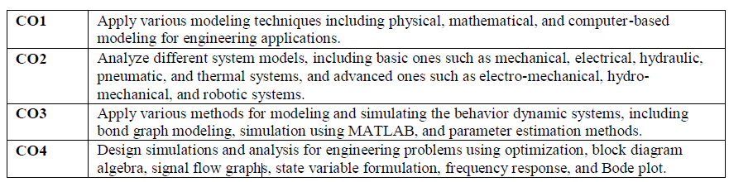
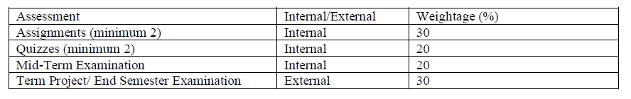
About the Course
Objectives:
This course intends to provide students with the ability to create and analyze mathematical models of physical systems using various techniques such as bond graph modeling and system transfer functions.
This course aims to equip students with the skills to use simulation tools such as MATLAB to simulate and analyze the behavior of dynamic systems and validate and verify simulation models.
The course aims to develop student’s abilities to apply system analysis and optimization techniques such as block diagram algebra, signal flow graphs, state variable formulation, frequency response, and Bode plot, to engineering problems.
Dr. Mrittunjoy Guha Majumdar
Assistant Professor (Sr. Gr.)
Chair, Quantum Information and Intelligence Systems Group
PhD from University of Cambridge in Quantum Information Processing in 2019
Postdoctoral Fellow at
  Harvard University
  Indian Institute of Science (IISc)
  Tata Institute of Fundamental Research (TIFR)
Certification in Artificial Intelligence and Machine Learning from the MIT Stephen A. Schwarzman College of Computing, Massachusetts Institute of Technology (MIT)

Slide 3
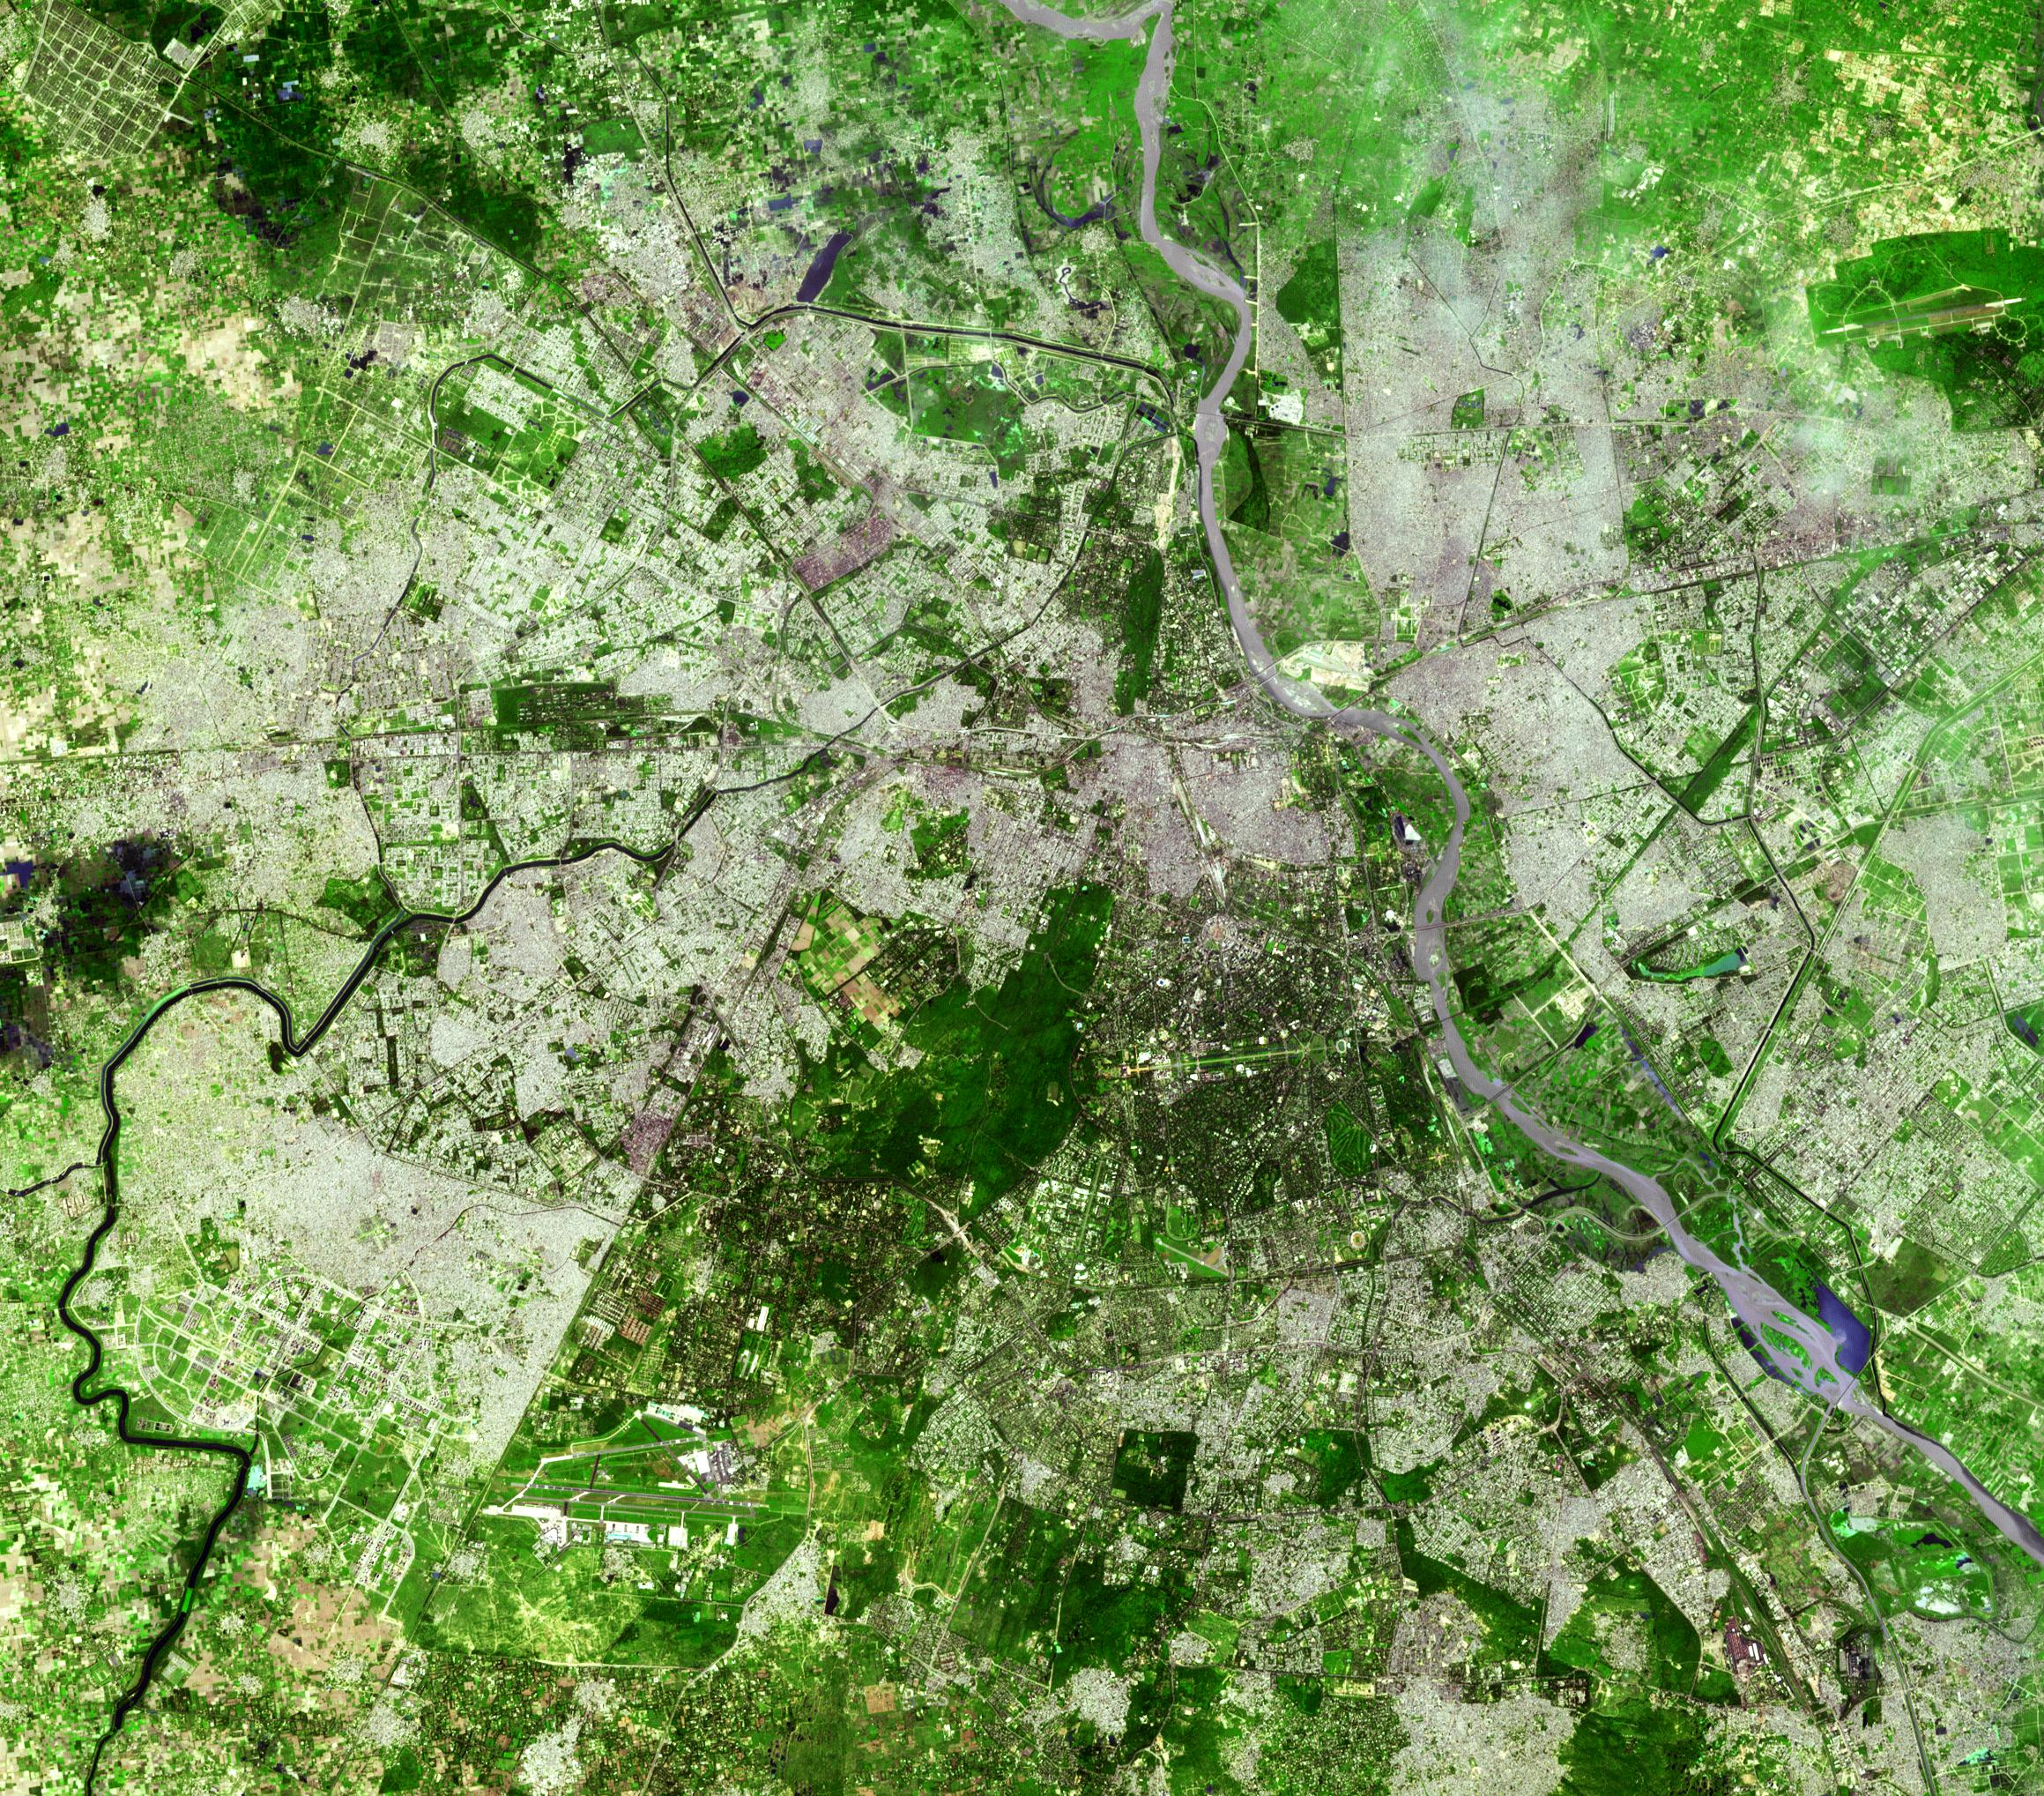
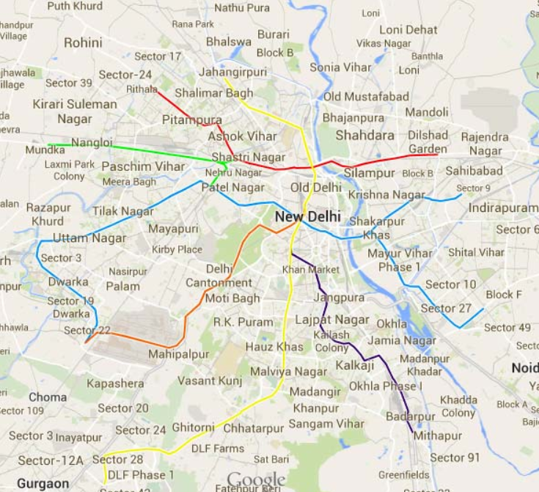
Modeling refers to the development of a mathematical representation of a physical situation.
Simulation refers to the procedure of solving the equations that resulted from model development.
“A model is an idealization. Its relationship to the real problem is like that of the map of the London tube trains to the real tube systems: a gross simplification, but one that captures certain essentials.”
                Michael Farries Ashby, University of Cambridge
Empirical and Conceptual Mapping of Delhi Metro Connectivity
The distances and directions are approximations, coarse-graining over irrelevant details.
Correct modelling can have predictive value.

Slide 4

A model is a mathematical statement about a system originally defined and characterized in non-mathematical terms.
A model can be explicative: able to define the system-in-question in terms of more basic, simpler processes. There are other systems like the Black-Scholes equation that does not quite do that when it talks about stocks.
Whether explicative or not, a model inherently is predictive in its nature.
Statistical Models: Used to explain or predict in probabilistic terms, handling randomness and cause-effect or prediction in uncertain environments.
Discrete and Black-box Models: Include methods like optimal scheduling or network routing (intrinsically discrete), as well as neural nets/genetic algorithms that predict outputs without explaining inner workings.
Lumped-parameter Models: Simplify complex systems by representing them with simple, aggregate descriptions such as spring–dashpot combinations in mechanical modeling.

Slide 5
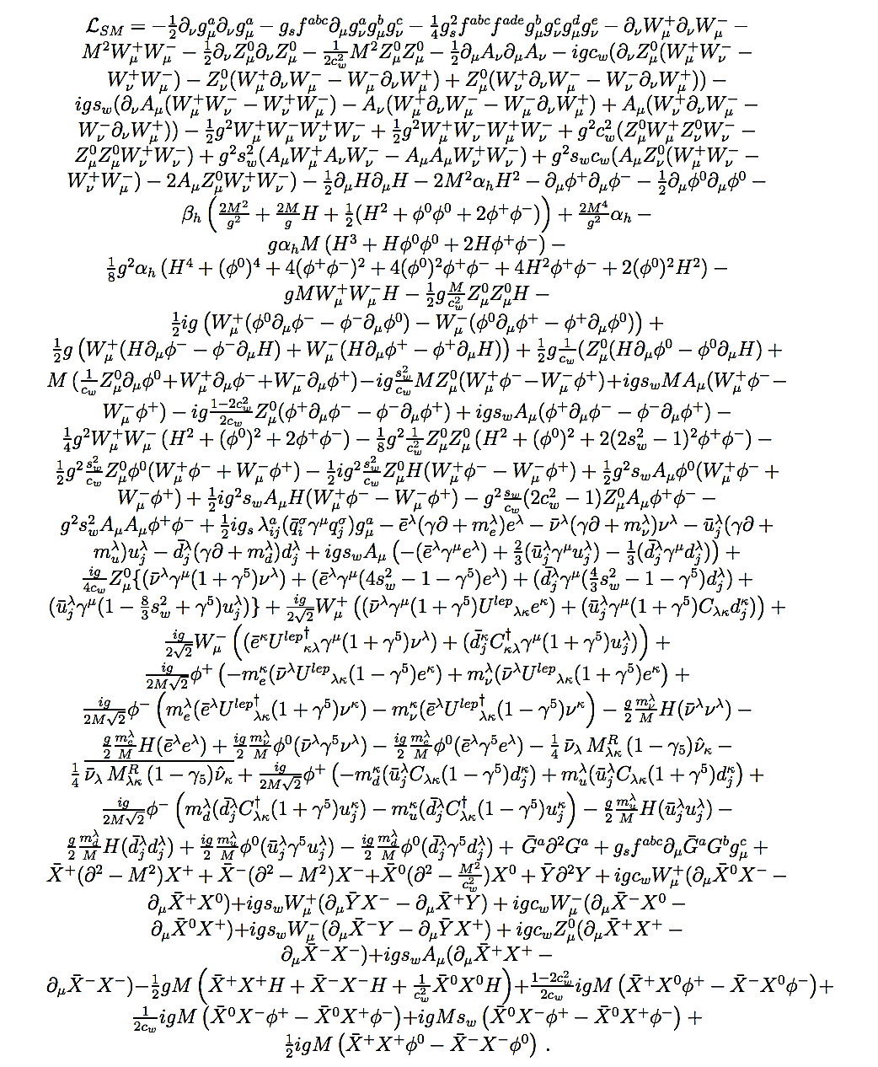
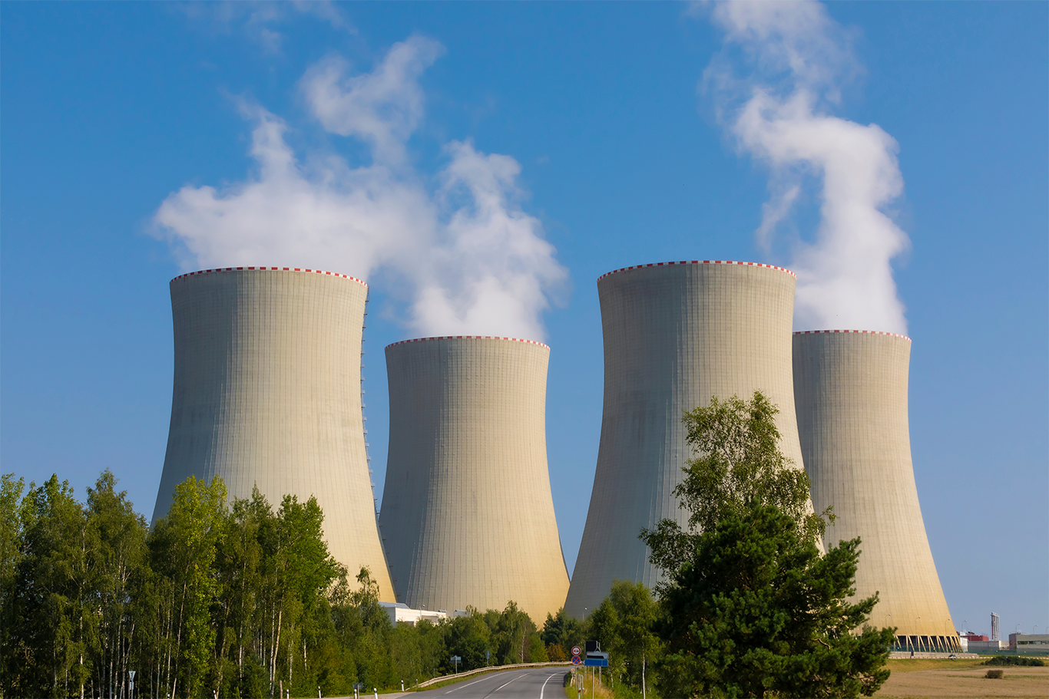
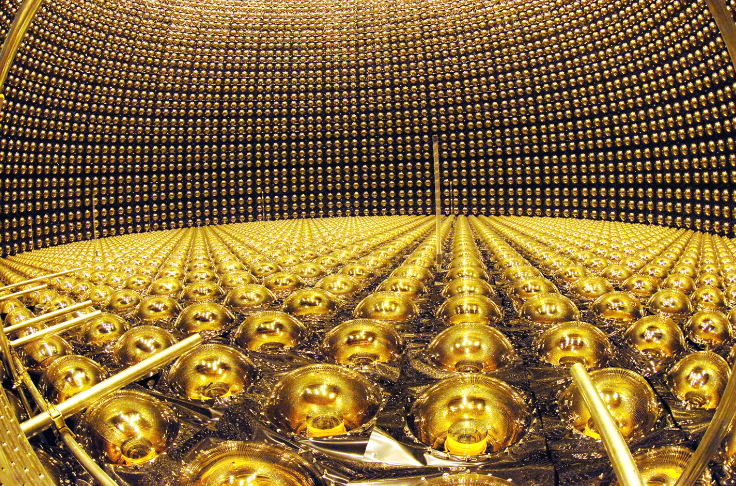
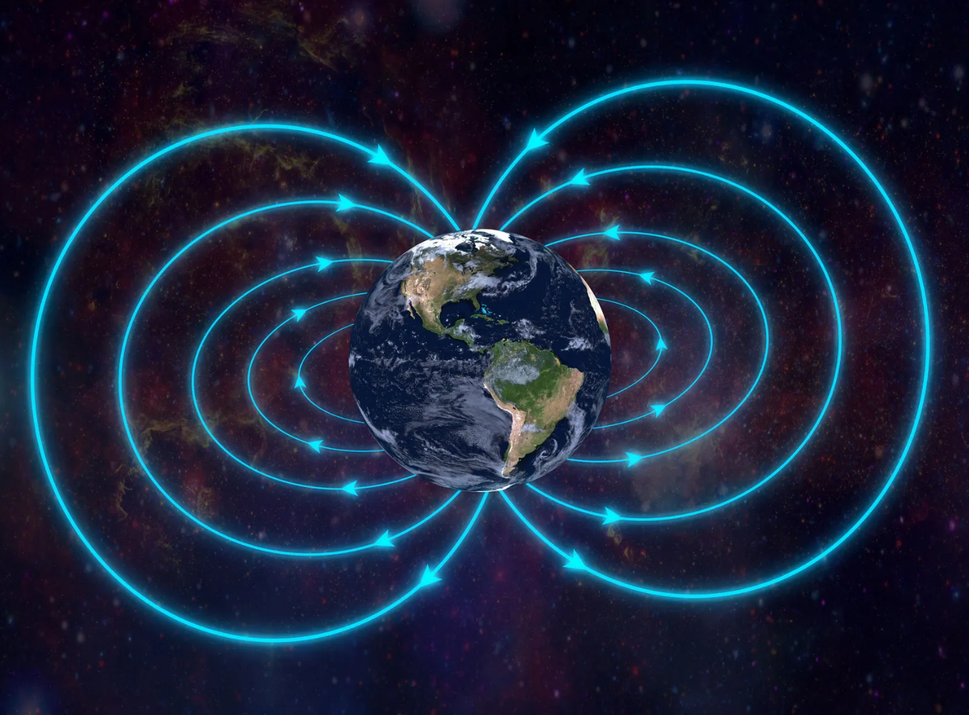
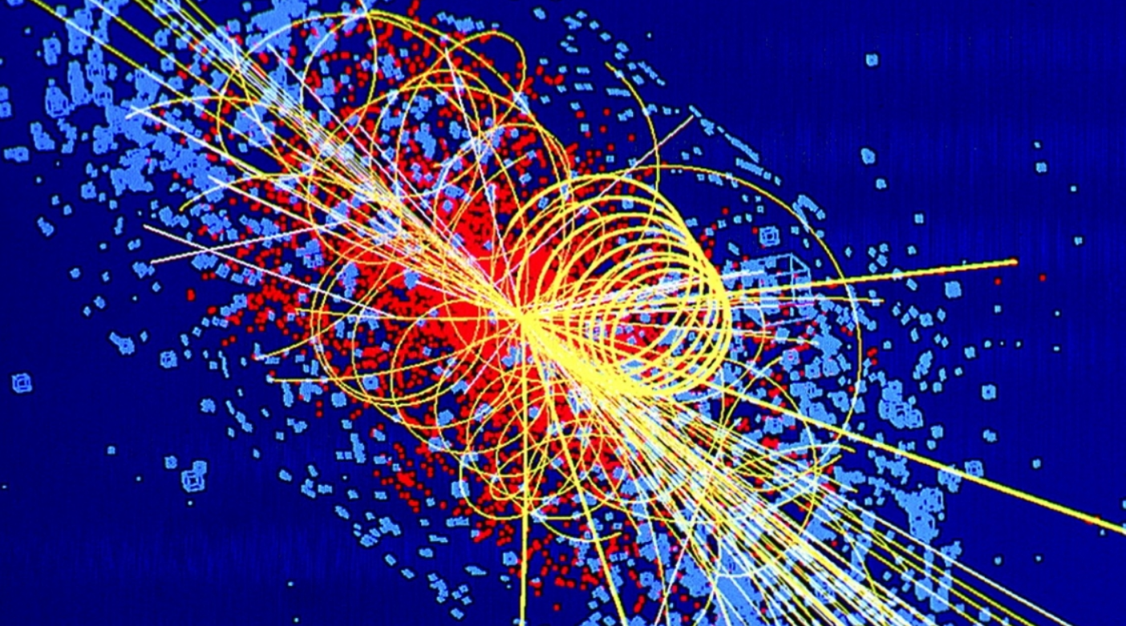
all explained by
Standard Model Lagrangian
The equation that describes all of physics except gravity

Slide 6
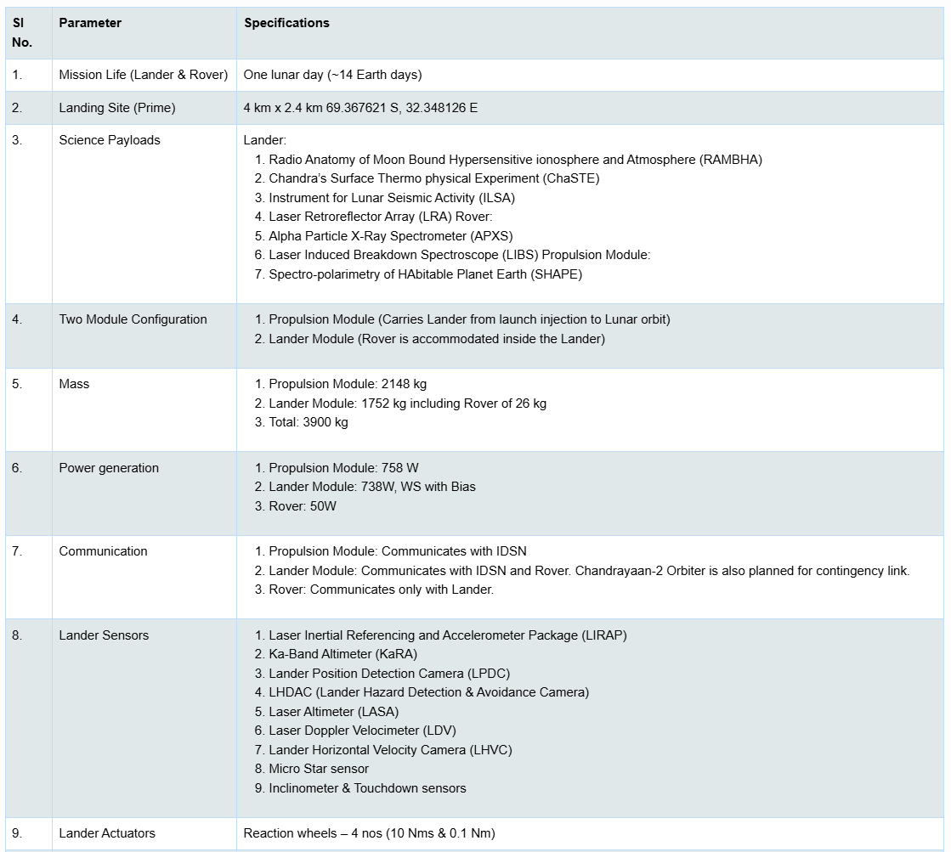
Chandrayaan 3 Specifications
How did we come to these specific parameter values?

Slide 7
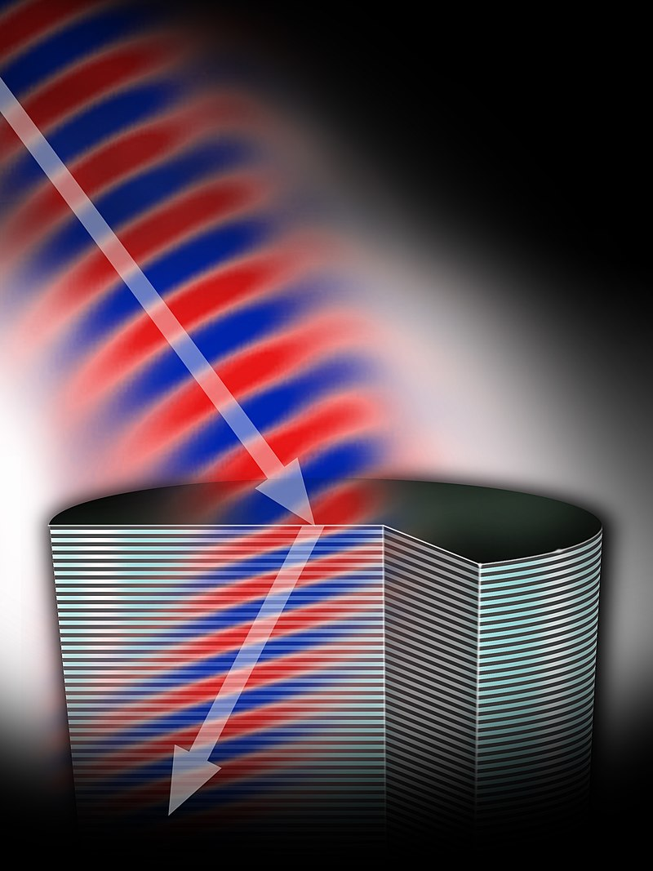
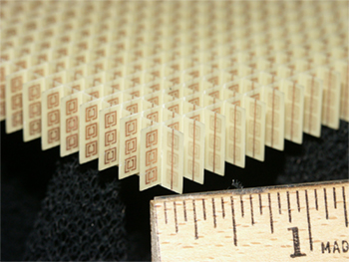
Scale-Based Modelling
Negative-Index Metamaterial
Split-Ring
Resonator
Array

Slide 8
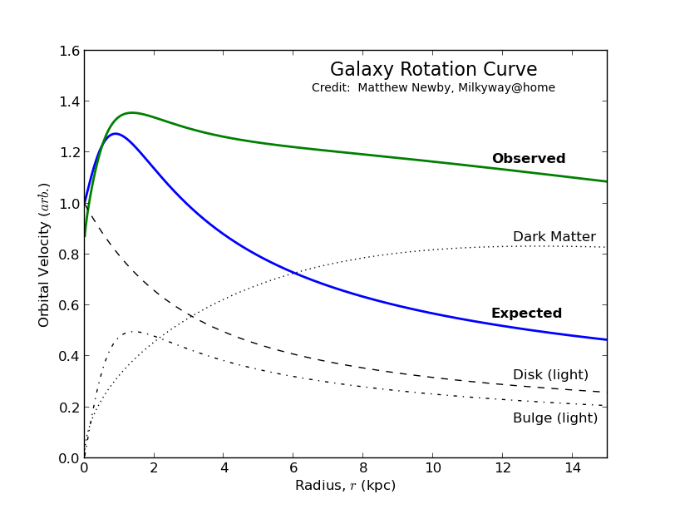
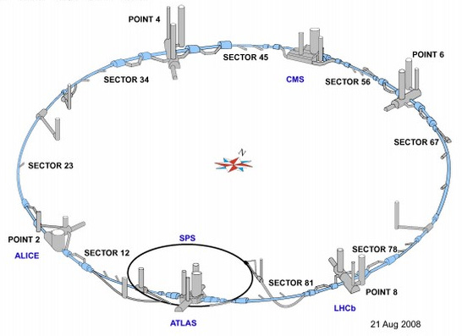
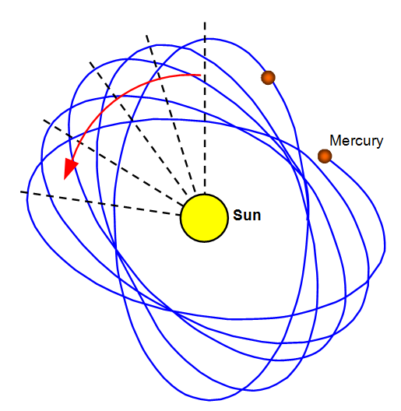
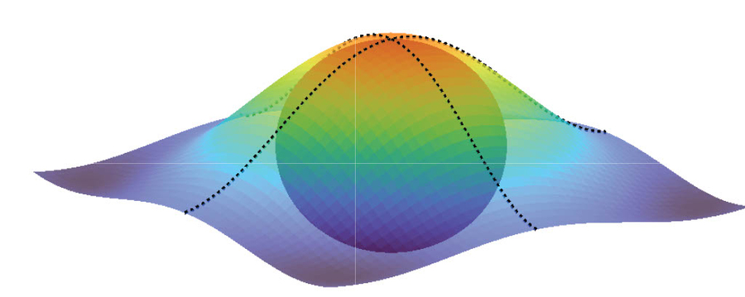




…
$${10}^{19} m$$
$${10}^{10} m$$
$${10}^{3} m$$
$${10}^{−15} m$$

Slide 9
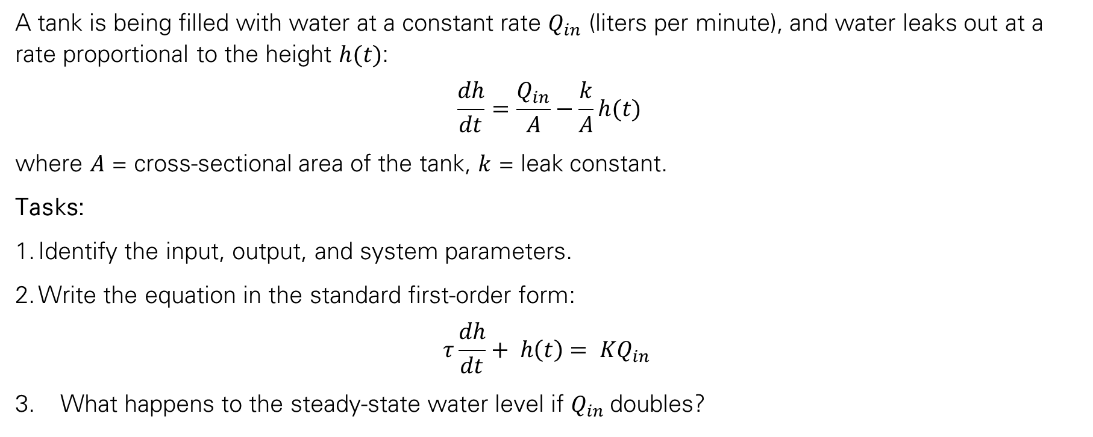
Tank Filling
A tank is being filled with water at a constant rate $Q_{in}$ (liters per minute), and water leaks out at a rate proportional to the height $h(t)$:
$$\frac{dh}{dt}=\frac{Q_{in}}{A}−\frac{k}{A}h(t)$$
where $A$ = cross-sectional area of the tank, $k$ = leak constant.
Tasks:
Identify the input, output, and system parameters.
Write the equation in the standard first-order form:
$$τ\frac{dh}{dt}+ h\left(t\right)= KQ_{in}$$
What happens to the steady-state water level if $Q_{in}$doubles?

Slide 10
Thought Problem: Virus Spreading on Campus
% Campus Virus Spread Simulation
N = 50; % total students
infected = 1; % initially infected
steps = 200; % simulation steps
L = 100; % campus grid size
p_infect = 0.4; % infection probability (no mask)
vaccinated = 10; % number vaccinated
% States: 0=Susceptible, 1=Infected, 2=Recovered, 3=Vaccinated
state = zeros(1,N);
state(1:infected) = 1;
state(end-vaccinated+1:end) = 3;
% Positions
pos = rand(N,2)*L;
for t=1:steps
% Random movement
pos = pos + randn(N,2)*2;
pos = max(min(pos,L),0);
% Infection check
for i=1:N
if state(i)==1
for j=1:N
if state(j)==0 % susceptible
if norm(pos(i,:)-pos(j,:)) < 3 && rand < p_infect
state(j)=1; % infection spreads
end
end
end
end
end
% Recovery chance
rec = (rand(1,N)<0.01) & (state==1);
state(rec)=2;
% Plot
clf;
scatter(pos(state==0,1),pos(state==0,2),'bo'); hold on; % Susceptible
scatter(pos(state==1,1),pos(state==1,2),'ro','filled'); % Infected
scatter(pos(state==2,1),pos(state==2,2),'go'); % Recovered
scatter(pos(state==3,1),pos(state==3,2),'ko','filled'); % Vaccinated
title(['Step ' num2str(t)]);
axis([0 L 0 L]); drawnow;
end

Slide 11

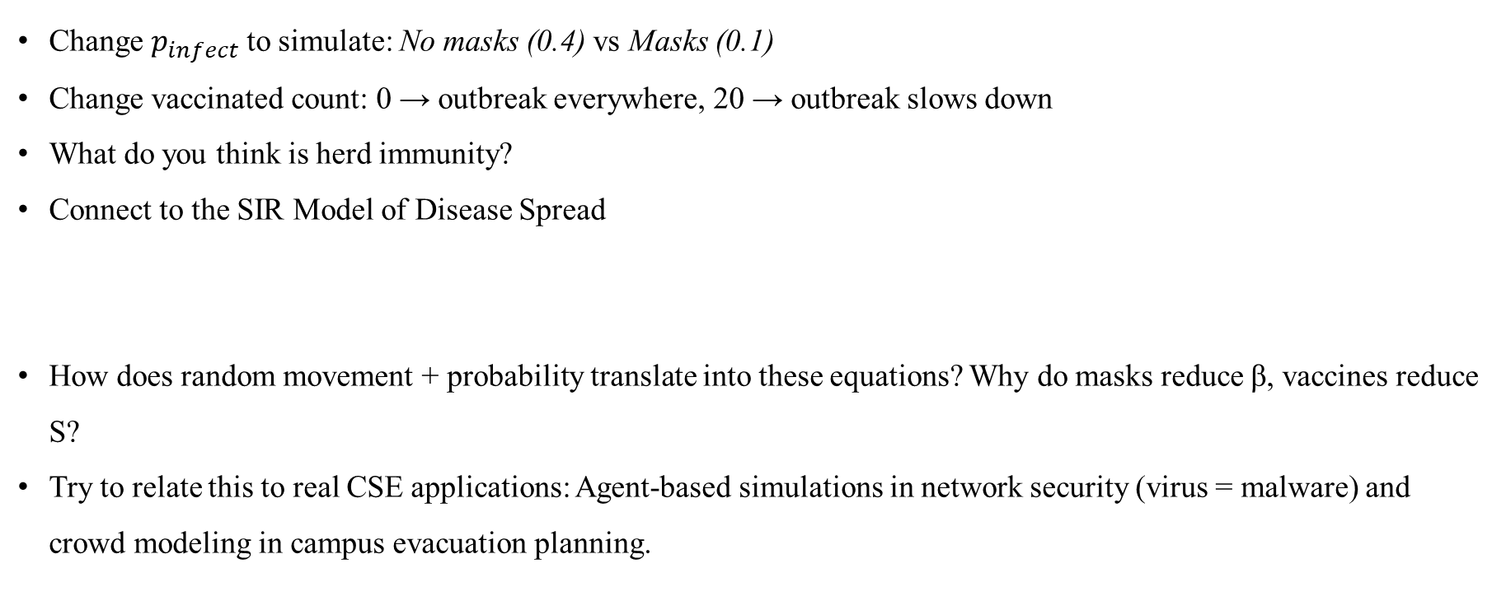
Thought Problem: Virus Spreading on Campus
Change $p_{infect}$ to simulate: No masks (0.4) vs Masks (0.1)
Change vaccinated count: 0 → outbreak everywhere, 20 → outbreak slows down
What do you think is herd immunity?
Connect to the SIR Model of Disease Spread
How does random movement + probability translate into these equations? Why do masks reduce β, vaccines reduce S?
Try to relate this to real CSE applications: Agent-based simulations in network security (virus = malware) and crowd modeling in campus evacuation planning.

Slide 12
Modelling
Module 1
(10 Lectures)
Lecture 1: Introduction to Modelling
Lecture 2: Modelling of Dynamic Systems
Lecture 3: Introduction to Simulation with MATLAB
Lecture 4: Bond Graph Modelling
Lecture 5: Generation of System Equations
Lecture 6: Method of Drawing Bond Graph Models
Lecture 7: Basic System Models
Lecture 8: Mechanical and Electrical Systems
Lecture 9: Pneumatic and Thermal Systems*
Lecture 10: Causality and Bond Graph Modelling
(1 Tutorial Sheet, 1 Assignment, 1 Quiz)

Slide 13
Systems Dynamics
Module 2
(8 Lectures)
Lecture 11: System Models
Lecture 12: Linearity and Non-Linearity
Lecture 13: Combined Rotary and Translatory Systems
Lecture 14: Hydromechanical Systems* and Electro-Mechanical Systems
Lecture 15: Robotic Systems*
Lecture 16: Dynamic response of 1st and 2nd order systems
Lecture 17: Performance measures for 2nd order system
Lecture 18: System Transfer Functions
(1 Tutorial Sheet, 1 Quiz)

Slide 14
Control Systems
Module 3
(12 Lectures)
Lecture 19: Block Diagram Algebra
Lecture 20: Signal Flow Graphs
Lecture 21: State Variable Formulation
Lecture 22: Frequency Response and Bode Plots
Lecture 23: Simulation using MATLAB (Simple and Compound Pendulums)
Lecture 24: Computational Applications with MATLAB
Lecture 25: Planar Mechanisms and Wheeled Mobile Robots
Lecture 26: Validation and Verification of Simulation Models
Lecture 27: Parameter Estimation Methods and Examples
Lecture 28: System Identification
Lecture 29: Introduction to Optimization
Lecture 30: Optimization with Modeling Engineering Problems
(2 Tutorial Sheets, 1 Assignment)

Slide 15
No Con on Conduct
Attendance won’t be given to anyone coming after 10 minutes of official start-of-class time, or to anyone leaving mid-way. Students disturbing the decorum of the class will be asked to leave.
Students are expected to uphold the highest standards of academic integrity. Any form of plagiarism, cheating, or dishonesty (including using unauthorized resources during exams, copying assignments, or misrepresenting the work of others) will result in disciplinary actions as per the university's guidelines. Proper citation must be given when referencing external work, software libraries, or algorithms used in assignments and projects.
Collaborative learning is encouraged, but students must respect each other's work. Any collaborative efforts should be transparent and well-documented, with clear separation of individual contributions.
Students are expected to attend all classes, actively participate in discussions, and engage in practical exercises. If any student has less than 70% attendance in a specific module, then the student will have to appear for a different quiz, which will be more non-trivial.
Respectful and constructive interactions should be maintained, both with peers and instructors. Disruptive behavior, including inappropriate comments or distractions, will not be tolerated. The course has a strict no-shaming policy.
Students are required to submit assignments, projects, and any other coursework on time. Late submissions will incur penalties (-5% per day of delay) unless expressly allowed by the instructor.
Students must ensure that all computational tools, software, and libraries used in assignments or projects are licensed and authorized for academic use. Unauthorized use of proprietary software or libraries that violate licensing agreements is prohibited.
Any indiscipline during the course that is beyond reasonable consideration will lead to an Open-ChatGPT test, which will account for 50% of the internal assessment.

Slide 16
Resources
Borutzky, Wolfgang, "Bond Graph Modelling of Engineering Systems", Springer, 2011.
Esfandiari, Ramin S. and Bei Lu, “Modeling and Analysis of Dynamic Systems”, CRC Press, 2010.
Gardner, John F., Bohdan T. Kulakowski, and J. Lowen Shearer. "Dynamic Modeling and Control of Engineering Systems." Cambridge University Press; 3rd edition (2008).
Karnopp, Dean C., Donald L. Margolis, and Ronald C. Rosenberg. "System Dynamics: Modeling, Simulation, and Control of Mechatronic Systems." Wiley; 5th edition (2012).
Lennart, L. and Torkel, G., “Modeling of Dynamic Systems”, Prentice Hall, 1994.
Woods, Robert L. and Kent L. Lawrence. "Modeling and Simulation of Dynamic Systems.” Prentice Hall; 1st edition (1997).
  More resources will be suggested during the course.
Dr. Mrittunjoy Guha Majumdar, Amrita Vishwavidyapeetham Delhi NCR

